Slide 1
Harris County Department of Education School Finance Meeting
September 2021

Slide 2
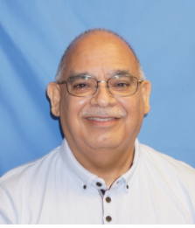
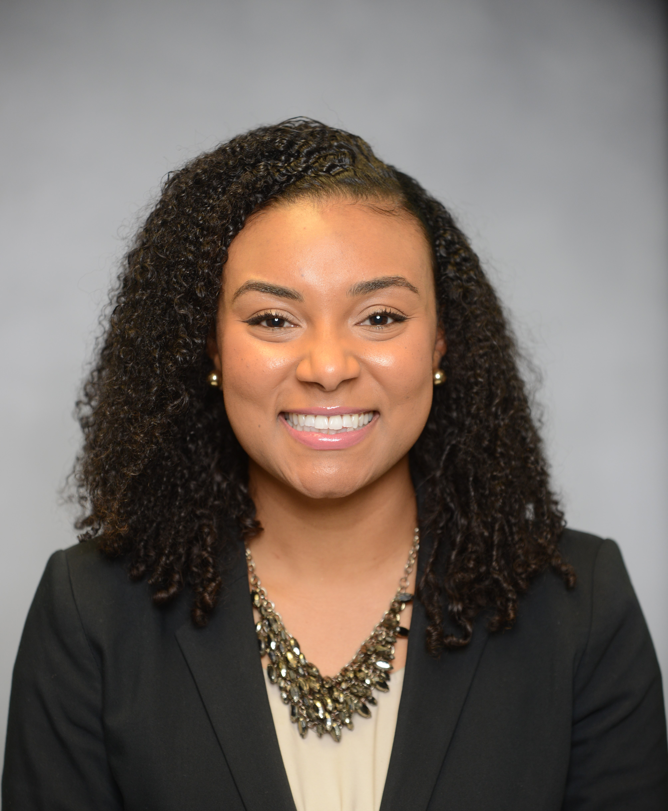
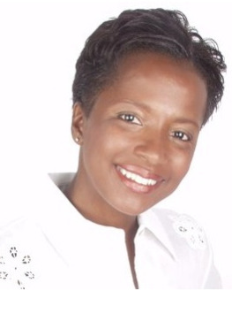
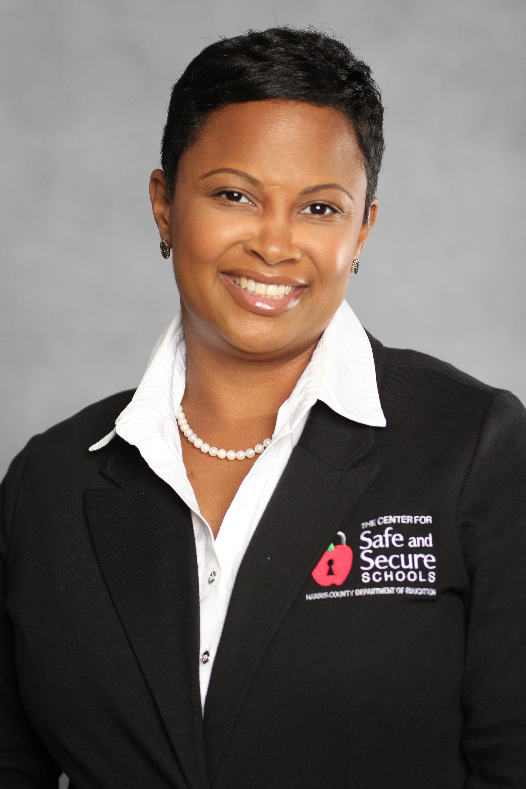
Our Team
Julia Andrews
Director
Gil Gaona
Administrative Assistant
Cierra Nickerson
Climate & Culture Specialist
Janice Owolabi
Safety Specialist

Slide 3
Our History
The Center was created in 1999 in response to a request by Harris County Superintendents
Our Mission
To support school districts and their efforts to have safe and secure learning environments
Physical Safety
Emotional Safety
Notes:
Physical School Safety:
-School Safety and Security Audits
-Emergency Operations Planning
-Standard Response Protocols and Standard Reunification Methods
-Threat Assessments
Emotional School Safety:
-Restorative Practices
-Youth Mental Health First Aid
-Crisis Prevention and Intervention
-De-escalation
-Mindfulness

Slide 4
Physical Safety
School Safety Audits
Threat Assessments
Emotional School Safety
Restorative Practices
Youth Mental Health First Aid
Emergency Operations Planning
Standard Response Protocols and Standard Reunification Methods
Crisis Prevention and Intervention
De-Escalation
Mindfulness

Slide 5
Physical Safety
Upcoming Physical School Safety Trainings:
Training | Dates
Basic Incident Command System (ICS) | October 13, 2021
Basic National Incident Management System (NIMS) | October 14, 2021
Janice Owolabi, Safety Specialist
Notes:
Incident Command System (ICS) and provides the foundation the history, features and principles, and organizational structure of the system. The course is designed to teach personnel how to operate efficiently during an incident or event within the Incident Command System (ICS). This part of the course provides training on and resources for personnel who are likely to assume a supervisory position within the ICS. There will be tabletop scenarios in the training to illustrate how ICS is used in the school emergency response environment.
National Incident Management System defines the comprehensive approach guiding the whole community - all levels of government, nongovernmental organizations (NGO), and the private sector - to work together seamlessly to prevent, protect against, mitigate, respond to, and recover from the effects of incidents. It also covers an introduction to National Response Framework (NRF) where the goal is to provide guidance for the whole community. Within this broad audience, the National Response Framework focuses especially on those who are involved in delivering and applying the response core capabilities.

Slide 6
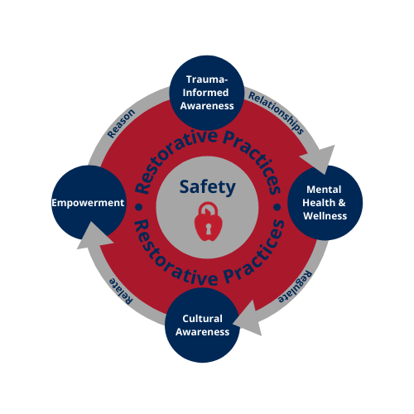
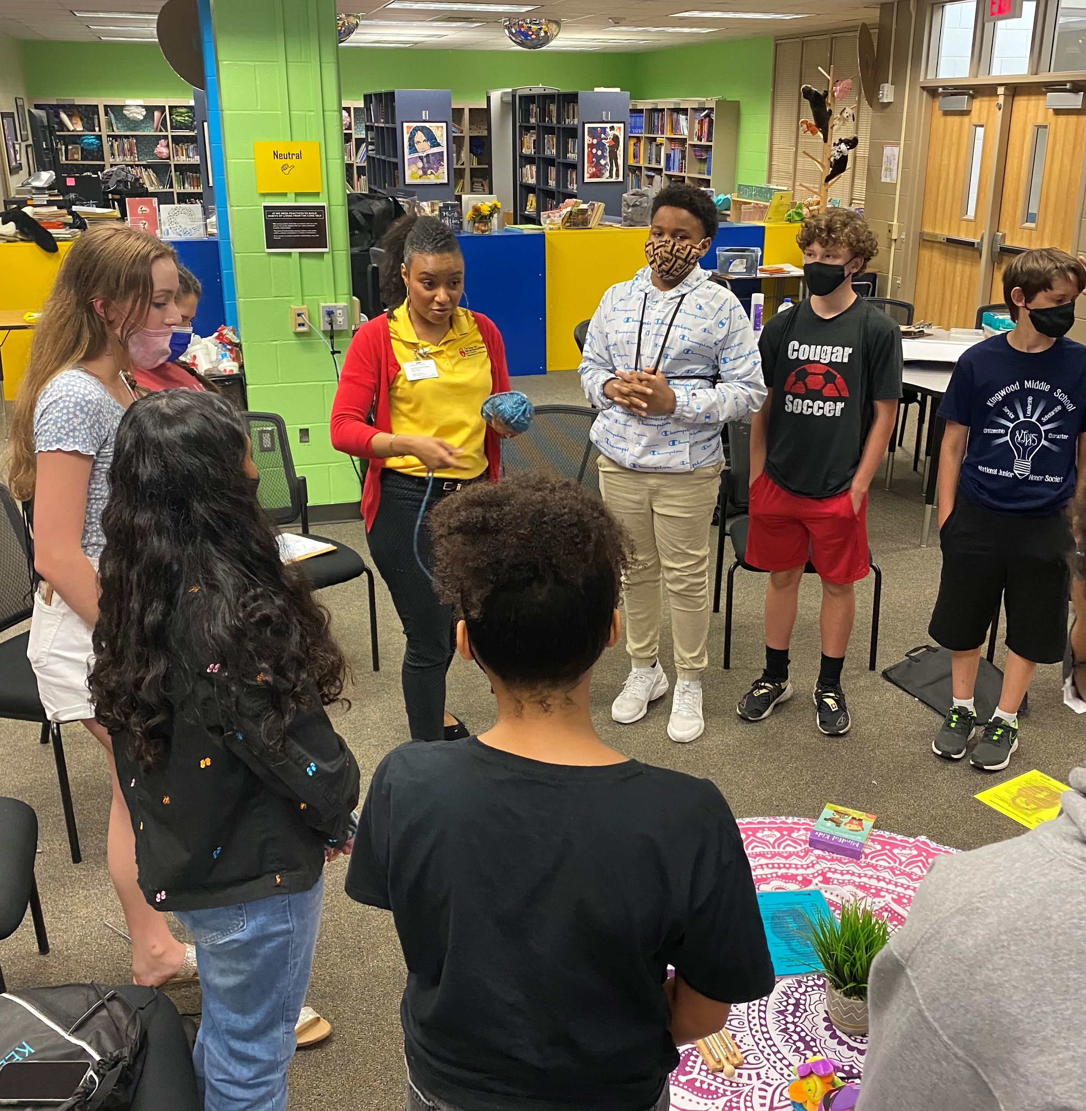
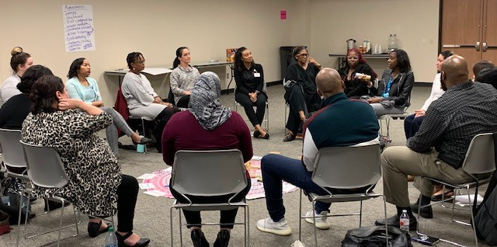
Emotional Safety
Upcoming Emotional Safety Trainings
Training | Dates
Tier 1 – Restorative Practices Training | October 21, 2021
Tier 2—Restorative Practices Training | October 28, 2021
Notes:
Tier 1_PREVENTION Build and Maintain Relationships, Prevent Conflict and Harm
Tier 2_RESPONSIVE Repair relationships, resolve conflict, manage difficulties and disruptions

Slide 7
Counselor’s Corner
Join Us!
M.A.S.K. – Mental Awareness Support Knowledge
October 14, 2021 | Times
Are You Hiding Behind Your M.A.S.K.? | Morning Session
SEL Coming Alive! | Afternoon Session
Notes:
MORNING SESSION
ARE YOU HIDING BEHIND YOUR M.A.S.K.? The counselors will learn how to unveil their own M.A.S.K (Mental Awareness Support Knowledge). Everyone wears a mask. Our masks remain regardless of the situation or the person you interact with.
AFTERNOON SESSION
SEL COMING ALIVE! SEL does not change the teaching methodology. Instead, it strengthens the relationship between the teacher and the student. School counselors will enhance their abilities to promote a positive environment by helping students manage the social/emotional demands of their lives.
Laurance Bogar is the CEO/Founder of Challenges Are Rewarding (C.A.R.). C.A.R. is a vehicle created to change behavior. This program provides tools and resources to help you understand how to navigate communication with individuals that exhibit challenging behaviors. Mrs. Bogar is a seasoned educational professional with years specializing in Social-Emotional Learning techniques and strategies. C.A.R is an experience that reaches beyond the classic workshop.

Slide 8
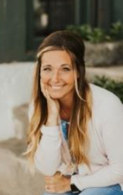
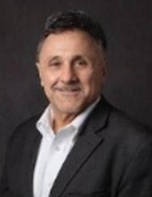
Notes:
Dr. Shannon Devlin and Dr. Frank DeAngelis: 9-10:30 a.m. Integrating Emotions
This session will highlight the experiences of two national safety professionals who walk-the-walk when it comes to responding to challenging school emergencies. Dr. Shannon Devlin will bring her expertise and day to day experience of dealing with school emergencies from the perspective of an incident commander, counselor and a first responder. She will focus on preparing emergency response plans for the emotional issues that will impact students, staff, and community. Mr. Frank DeAngelis will bring his expertise and life experience of dealing with the recovery of a campus and community in an emergency. He will draw from his personal experience of dealing with events that deeply impact students and the community.
Dr. Danielle Busby: 11-12:30 p.m. Surviving and Thriving through Trauma
A licensed psychologist with specific expertise in trauma-informed assessment and intervention of children and adolescents:
The Preparation * Effective Leadership Mindset: moving plan to action with fidelity. *Mental Preparation and Rehearsal: spectrum of tragedy and related trauma exposure. * Physical and Psychological First Aid: minimization of trauma exposure to the senses. * Incident Command Structures: It is not one and done.
The Recovery
* Provide Information on How To rebuild a community after a traumatic event * Provide information about creating a positive culture and learning events * Provide information about managing the after-crisis with students, staff members, community members and never-ending media attention * Provide personal experiences that resulted because of the tragedy

Slide 10
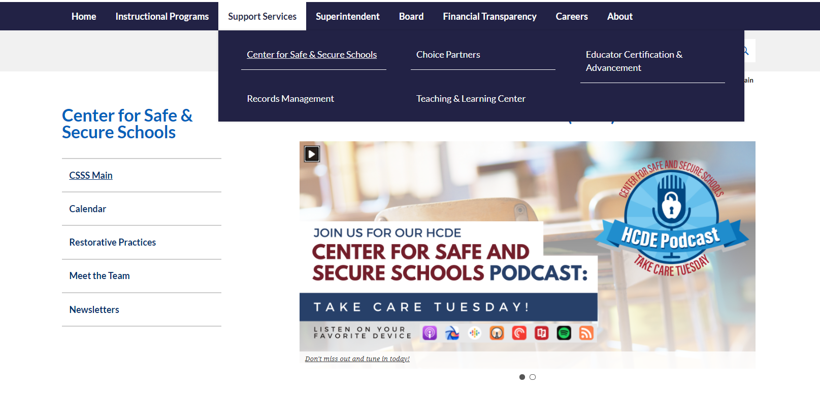
Visit Us!
hcde-texas.org

Slide 11
Thank you!
Contact us!
713-696-0771
ggaona@hcde-Texas.org
@CSSS_hcde
HCDE-CenterforSafeandSecureSchools

